Slide 1
Data
9/21/2021

Slide 2
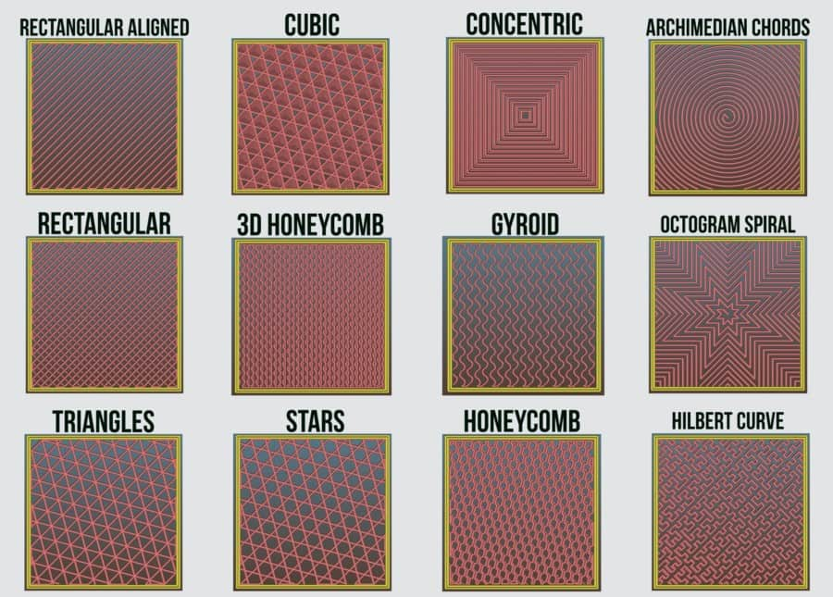
Printing patterns

Slide 3
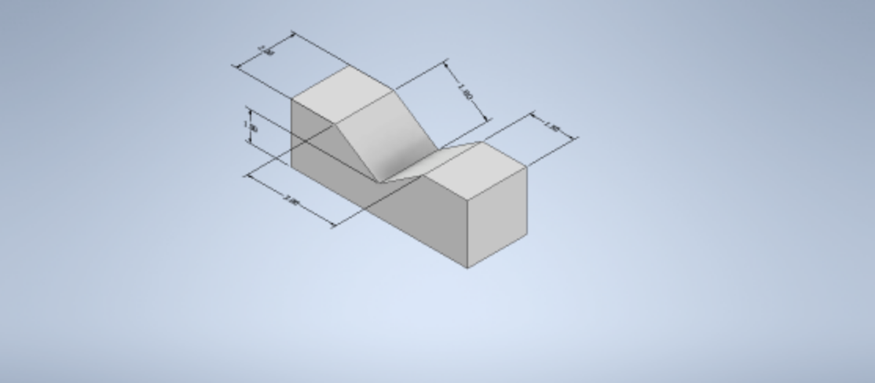
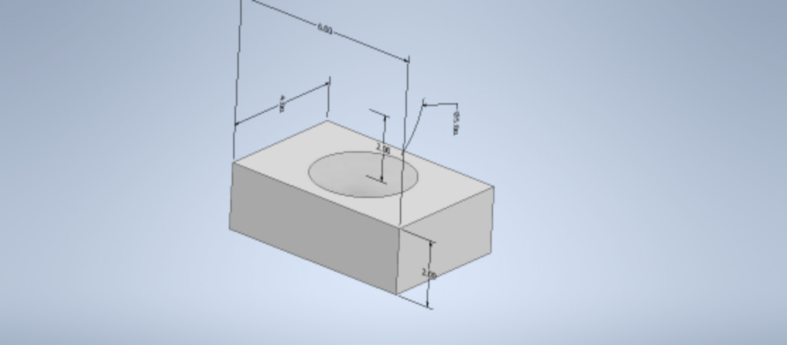
Printing base structures (damages)
T1
T4

Slide 4
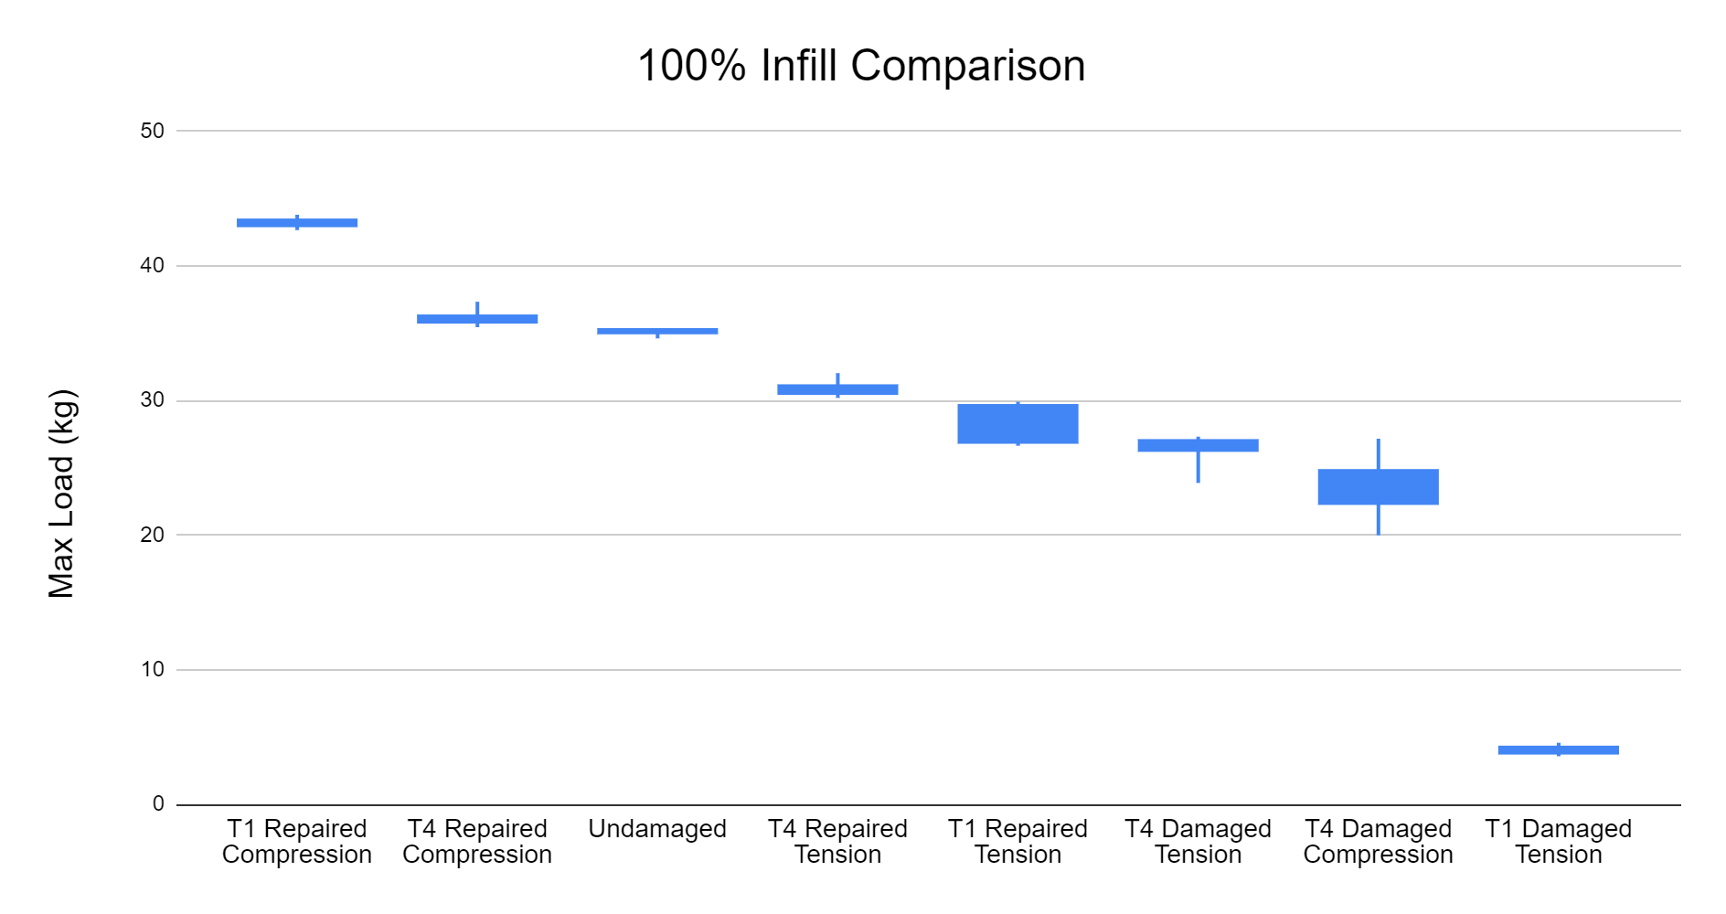

Slide 5
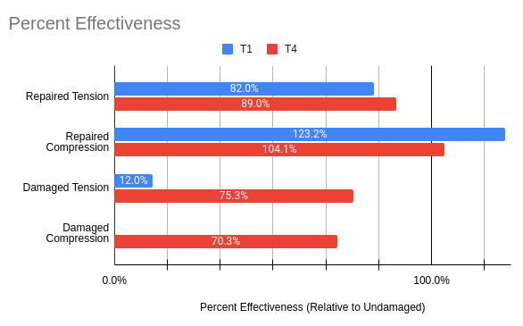

Slide 6
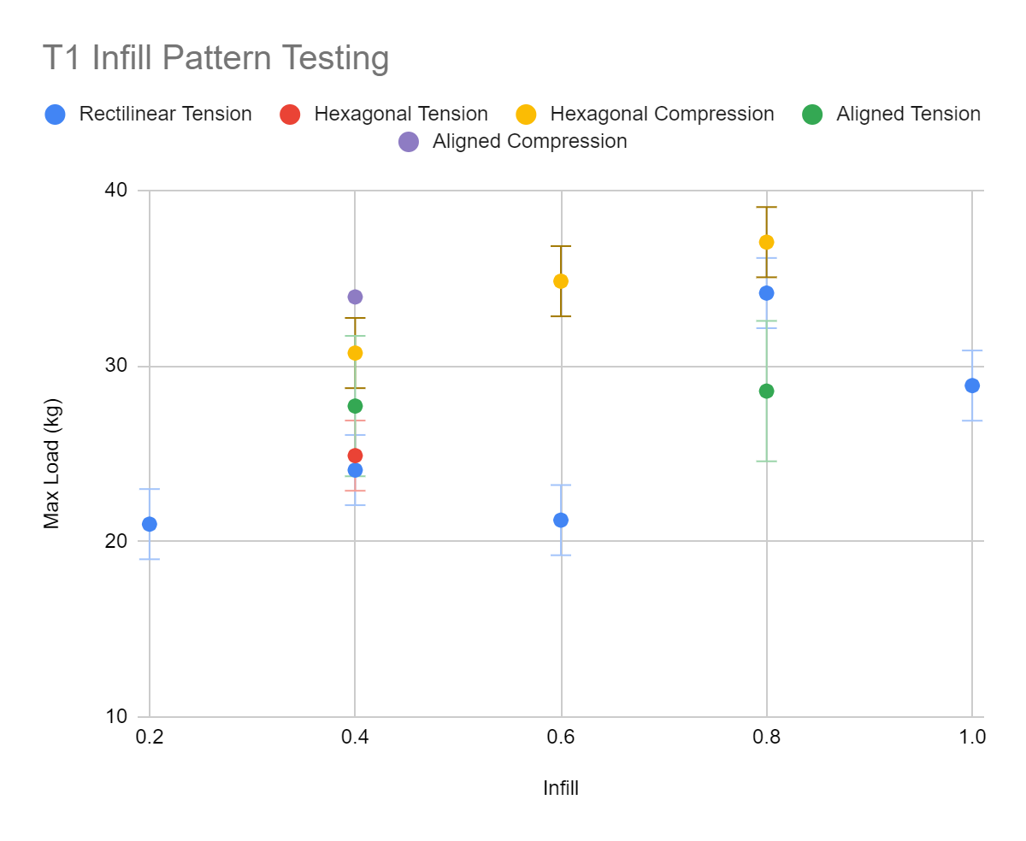

Slide 7
Remaining parts
T1 80% 60% 20% compression
Hexagonal 60% and 80% Tension T1
100% infill compression T1 x2
40% repaired compression T1 x3
Aligned 60% Compression and Tension
Aligned 80% Compression
T4 Damaged Compression x4 (or more)
T4 Repaired Compression x3 (or more)

Slide 8
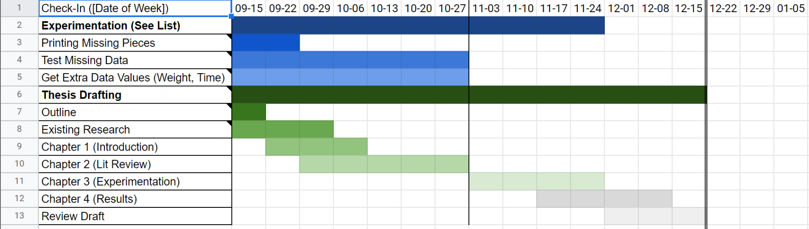
Schedule

